Slide 1
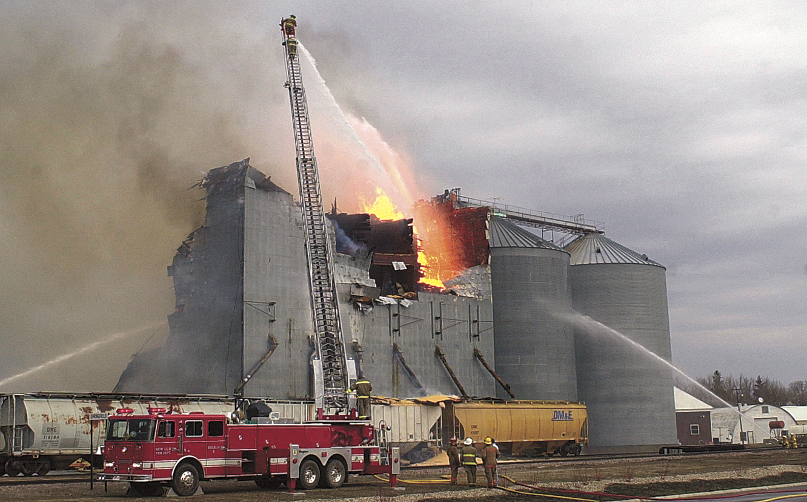
Chap 10.2 - The Process of Cellular Respiration
Notes:
Read the lesson title aloud to students.

Slide 2
What are the stages of cellular respiration? What happens in each? How much ATP is generated?

Slide 3
Learning Objectives
Identify what happens during glycolysis.
Identify what happens during the Krebs cycle.
Explain how the electron transport chain uses high-energy electrons from glycolysis and the Krebs cycle.
Calculate how much ATP cellular respiration generates.
Notes:
Click to reveal each of the learning objectives.
Ask students: What do you do every day to get ready for school?
Sample answer: I wake up, shower, dress, comb my hair, eat breakfast, brush my teeth, pack my lunch, and walk to the bus stop.
With students, create a list of steps the students take to get ready for school.
After the list is compiled, point out that “getting ready for school” is not just one thing, but rather a series of things to accomplish the one thing. Explain that cellular respiration is also a series of steps rather than a single event.
Make sure that students understand that at the end of the presentation they should be able to describe the stages of cellular respiration in some detail.

Slide 4
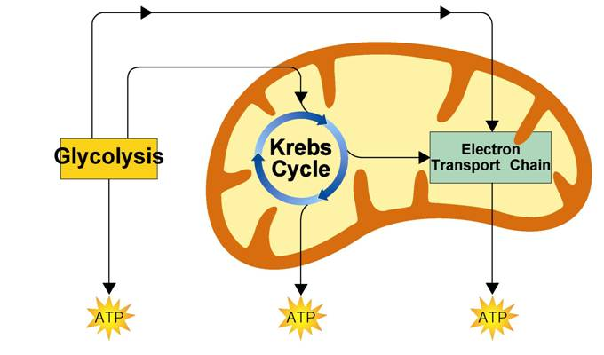
Overview of Cellular Respiration
Glycolysis takes place in the cytoplasm. The Krebs cycle and electron transport take place in the mitochondria.
Glycolysis
Cytoplasm
Mitochondrion
Notes:
Cellular respiration is the process that releases energy by breaking down food molecules in the presence of oxygen. Glycolysis takes place in the cytoplasm. The Krebs cycle and electron transport take place inside the mitochondria.

Slide 5
Glycolysis
What happens during the process of glycolysis?

Slide 6
Glycolysis
Glycolysis is the process in which one molecule of glucose is broken in half, producing two molecules of pyruvic acid, a 3-carbon compound.

Slide 7
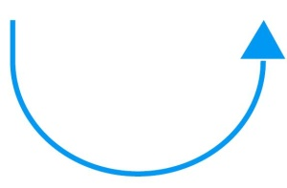
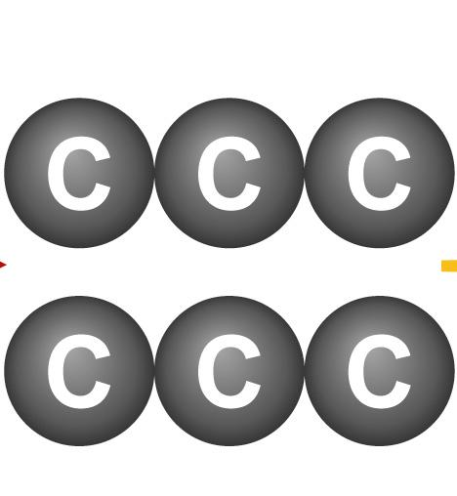
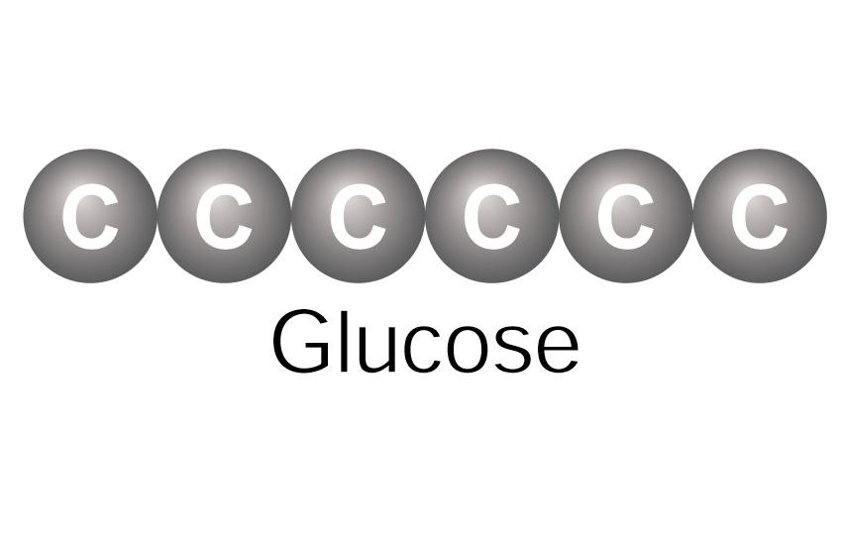
Glycolysis
ATP Production
At the beginning of glycolysis, the cell uses up 2 molecules of ATP to start the reaction.
2 ATP
2 ADP
4 ADP
4 ATP
Glucose
2 Pyruvic
acid
Notes:
Glycolysis is the first stage in cellular respiration. During glycolysis, glucose is broken down into 2 molecules of pyruvic acid.

Slide 8
Glycolysis
When glycolysis is complete, 4 ATP molecules have been produced.
2 ATP
2 ADP
4 ADP
4 ATP
Glucose
2 Pyruvic
acid

Slide 9
Glycolysis
This gives the cell a net gain of 2 ATP molecules.
2 ATP
2 ADP
4 ADP
4 ATP
Glucose
2 Pyruvic
acid

Slide 10
Glycolysis
NADH Production
One reaction of glycolysis removes 4 high-energy electrons, passing them to an electron carrier called NAD⁺.
2 ATP
2 ADP
4 ADP
4 ATP
Glucose
2NAD⁺
2 Pyruvic
acid

Slide 11
Glycolysis
Each NAD⁺ accepts a pair of high-energy electrons and becomes an NADH molecule.
2 ATP
2 ADP
4 ADP
4 ATP
Glucose
2NAD⁺
2 Pyruvic
acid
2

Slide 12
Glycolysis
The NADH molecule holds the electrons until they can be transferred to other molecules.
2 ATP
2 ADP
4 ADP
4 ATP
2NAD⁺
2 Pyruvic
acid
2
To the electron transport chain

Slide 13
Glycolysis
The Advantages of Glycolysis
The process of glycolysis is so fast that cells can produce thousands of ATP molecules in a few milliseconds.
Glycolysis does NOT require oxygen.

Slide 14
The Krebs Cycle
What happens during the Krebs cycle?

Slide 15
The Krebs Cycle
During the Krebs cycle, pyruvic acid is broken down into carbon dioxide in a series of energy-extracting reactions.
Because citric acid is the first compound formed in this series of reactions, it is also referred to as the citric acid cycle.

Slide 16
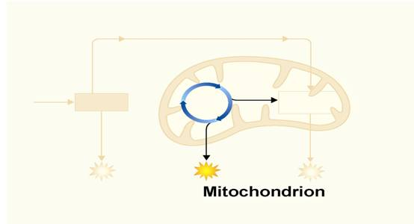
The Krebs Cycle
The Krebs cycle begins when pyruvic acid produced by glycolysis enters the mitochondrion.

Slide 17
The Krebs Cycle
One carbon molecule is removed, forming CO₂, and electrons are removed, changing NAD⁺ to NADH.

Slide 18
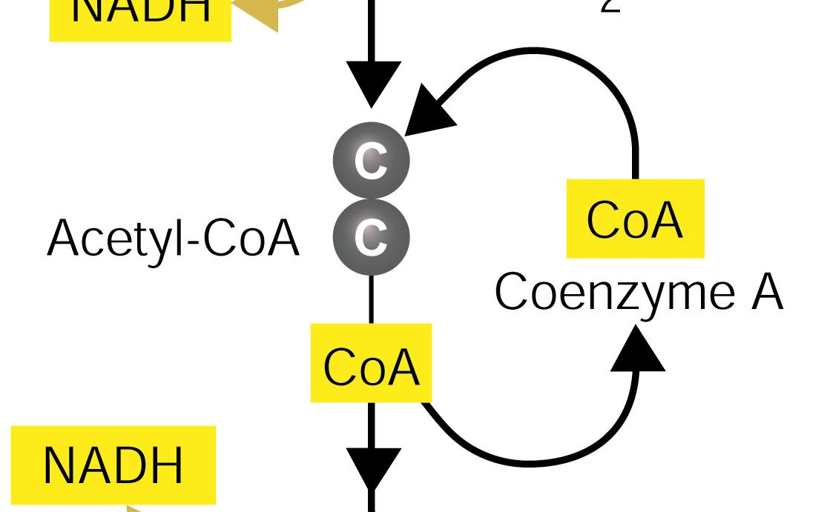
The Krebs Cycle
Coenzyme A joins the 2-carbon molecule, forming acetyl-CoA.

Slide 19
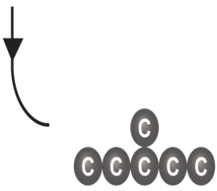
The Krebs Cycle
Acetyl-CoA then adds the 2-carbon acetyl group to a 4-carbon compound, forming citric acid.
Citric acid

Slide 20
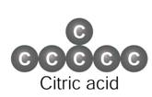
The Krebs Cycle
Citric acid is broken down into a 5-carbon compound, then into a 4-carbon compound.

Slide 21
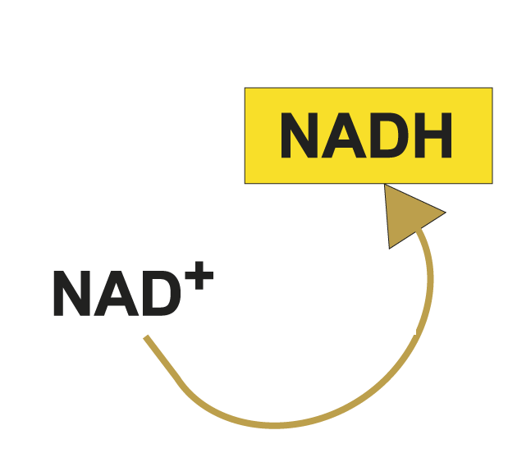
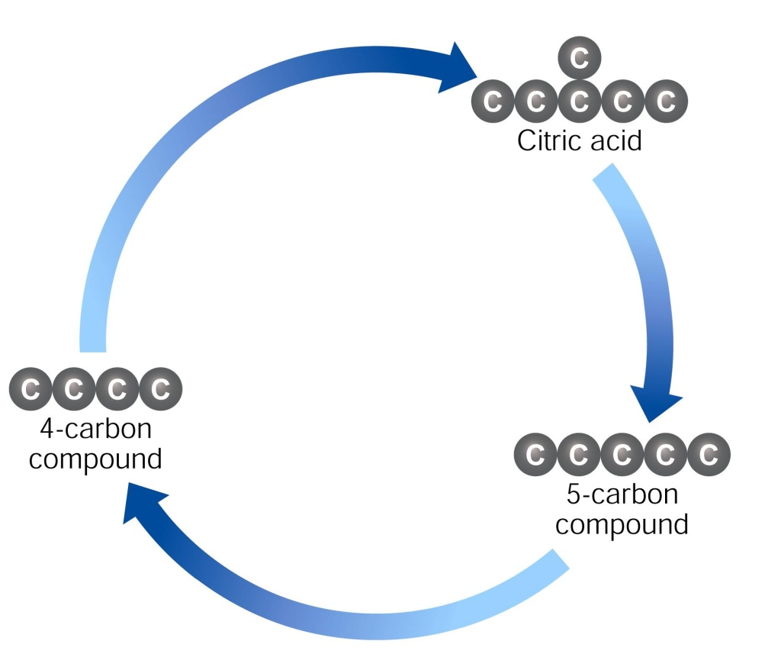
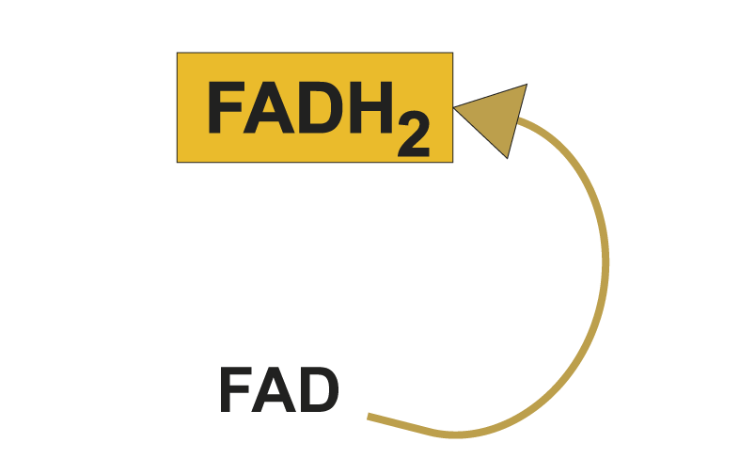
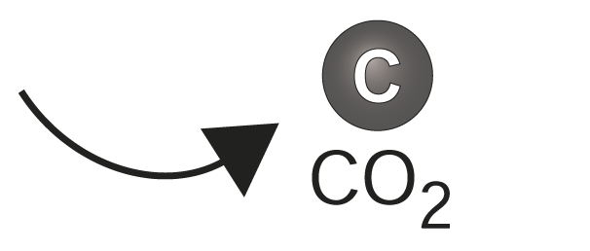
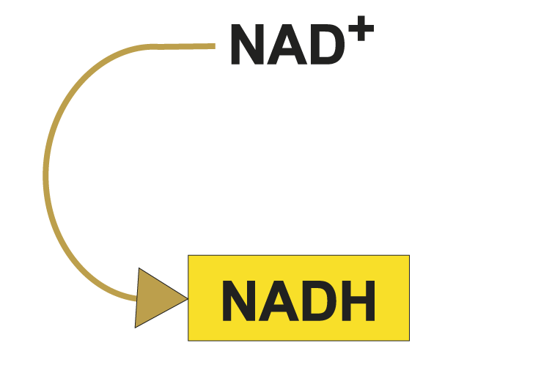
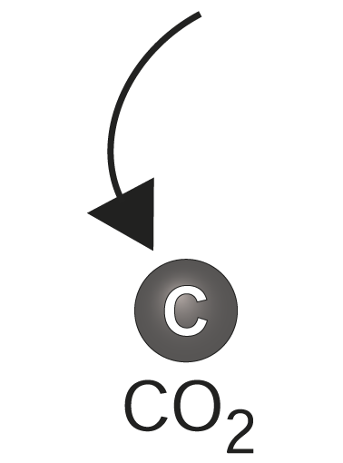
The Krebs Cycle
Two more molecules of CO₂ are released and electrons join NAD⁺ and FAD, forming NADH and FADH₂

Slide 22
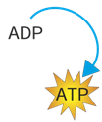
The Krebs Cycle
In addition, one molecule of ATP is generated.
Notes:
The complete breakdown of glucose through cellular respiration, including glycolysis, results in the production of 36 molecules of ATP.

Slide 23
The Krebs Cycle
The energy tally from 1 molecule of pyruvic acid is
4 NADH
1 FADH₂
1 ATP

Slide 24
Electron Transport
How are high-energy electrons used by the electron transport chain?

Slide 25
Electron Transport
Electron Transport
The electron transport chain uses the high-energy electrons from the Krebs cycle to convert ADP into ATP.

Slide 26
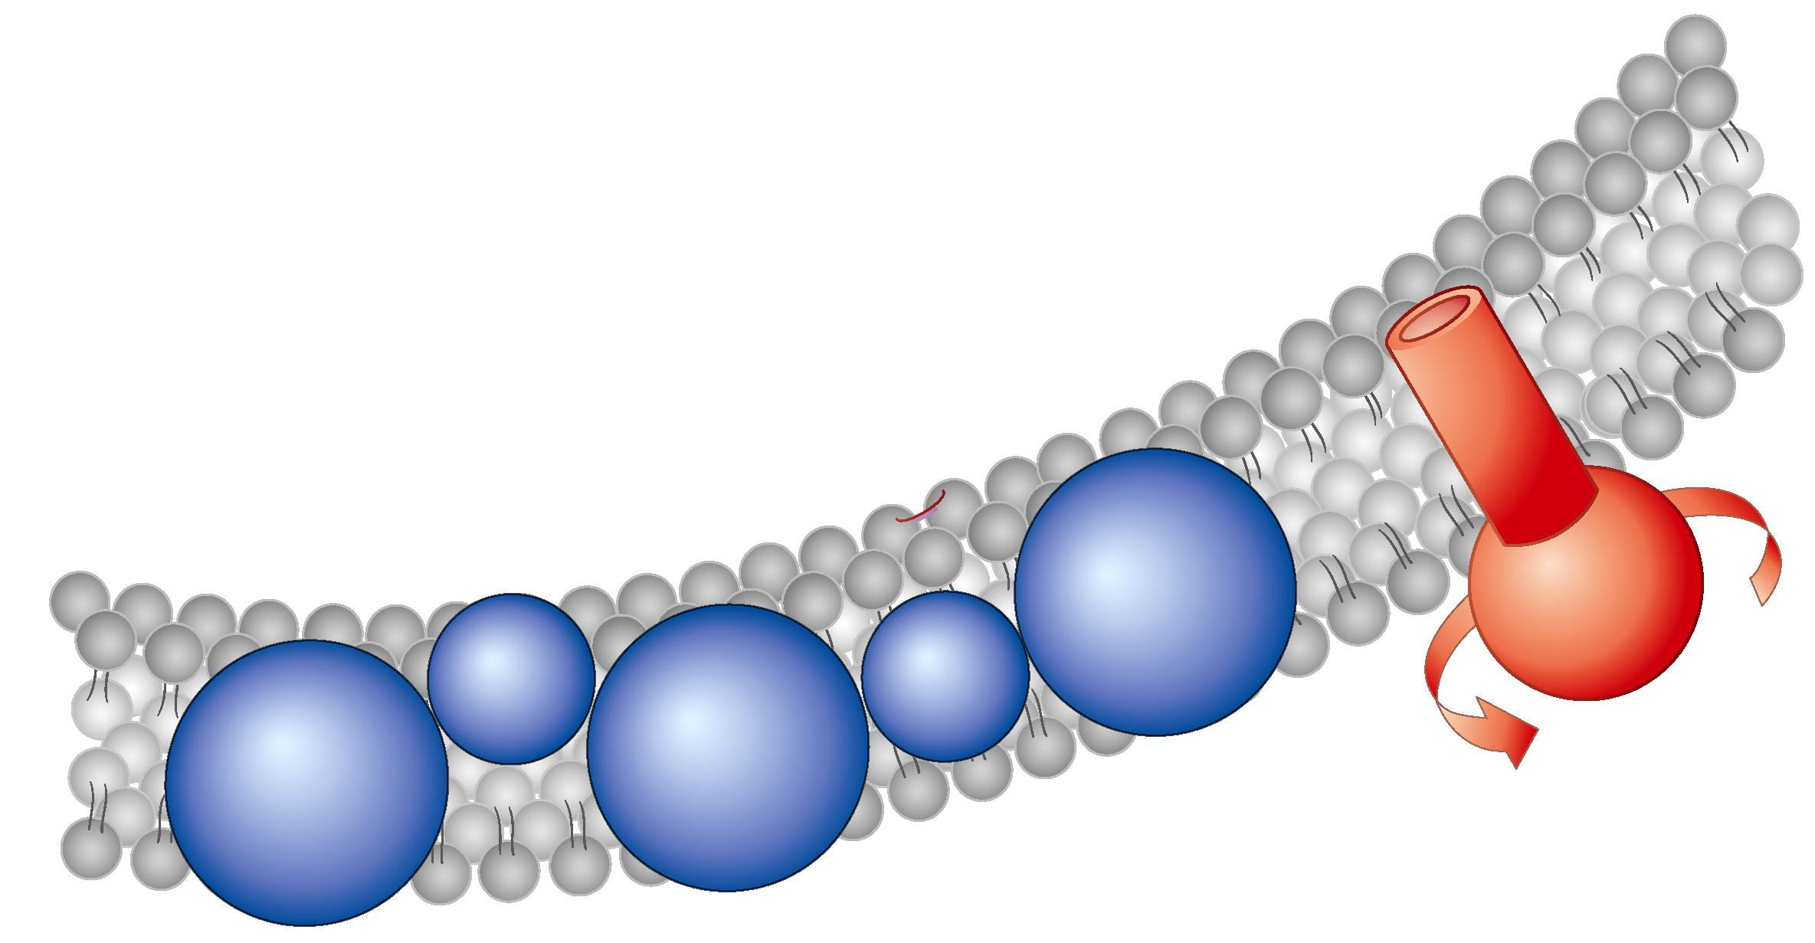
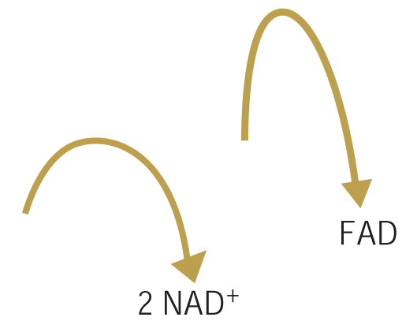
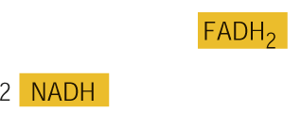
Electron Transport
High-energy electrons from NADH and FADH₂ are passed along the electron transport chain from one carrier protein to the next.

Slide 27
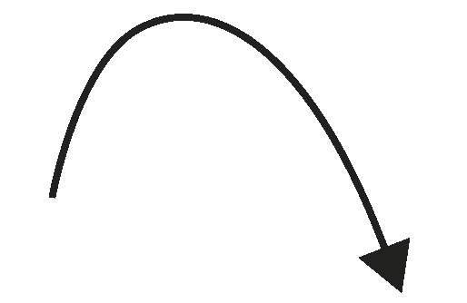
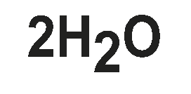
Electron Transport
At the end of the chain, an enzyme combines these electrons with hydrogen ions and oxygen to form water.

Slide 28
Electron Transport
As the final electron acceptor of the electron transport chain, oxygen gets rid of the low-energy electrons and hydrogen ions.

Slide 29
Electron Transport
When 2 high-energy electrons move down the electron transport chain, their energy is used to move hydrogen ions (H⁺) across the membrane.

Slide 30
Electron Transport
During electron transport, H⁺ ions build up in the intermembrane space, so it is positively charged.

Slide 31
Electron Transport
The other side of the membrane, from which those H⁺ ions are taken, is now negatively charged.

Slide 32
Electron Transport
The inner membranes of the mitochondria contain protein spheres called ATP synthases.
ATP synthase

Slide 33
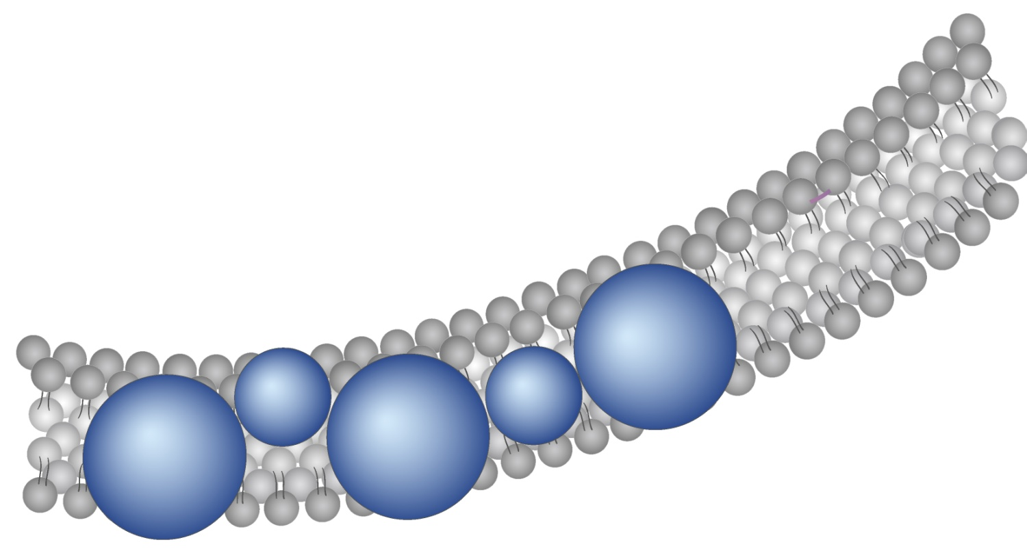
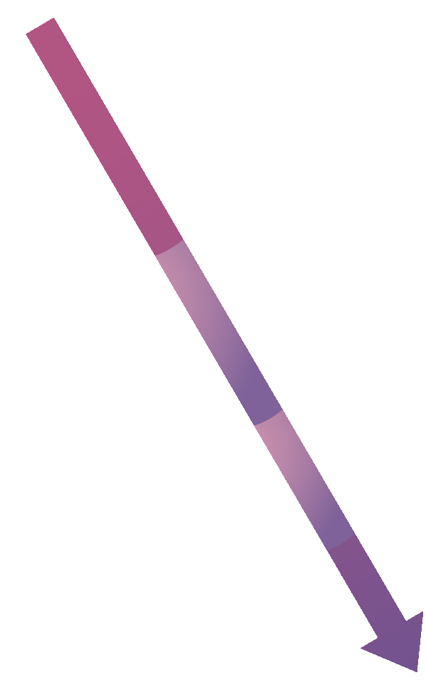
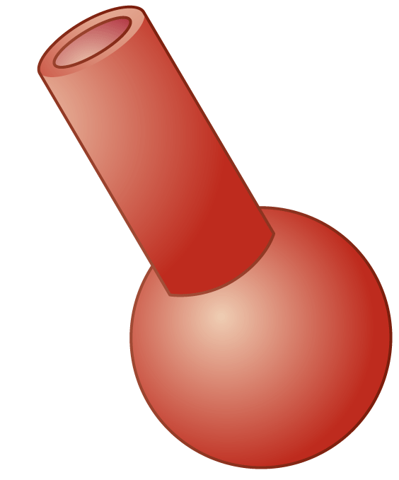
Electron Transport
As H⁺ ions escape through channels into these proteins, the ATP synthase spins.
Channel
ATP synthase
Notes:
The electron transport chain uses high-energy electrons from the Krebs cycle to convert ADP to ATP.

Slide 34
Electron Transport
As it rotates, the enzyme grabs a low-energy ADP, attaching a phosphate, forming high-energy ATP.
Channel
ATP synthase
ATP
Notes:
The electron transport chain uses high-energy electrons from the Krebs cycle to convert ADP to ATP.

Slide 35
The Totals
The Totals
Glycolysis produces just 2 ATP molecules per molecule of glucose.
The complete breakdown of glucose through cellular respiration, including glycolysis, results in the production of 36 molecules of ATP.

Slide 36
The Totals
Notes:
The complete breakdown of glucose through cellular respiration, including glycolysis, results in the production of 36 molecules of ATP.

